Slide 1

Modern React Frontend Architecture
Building Scalable, Type-Safe, and Efficient Web Applications

Slide 2
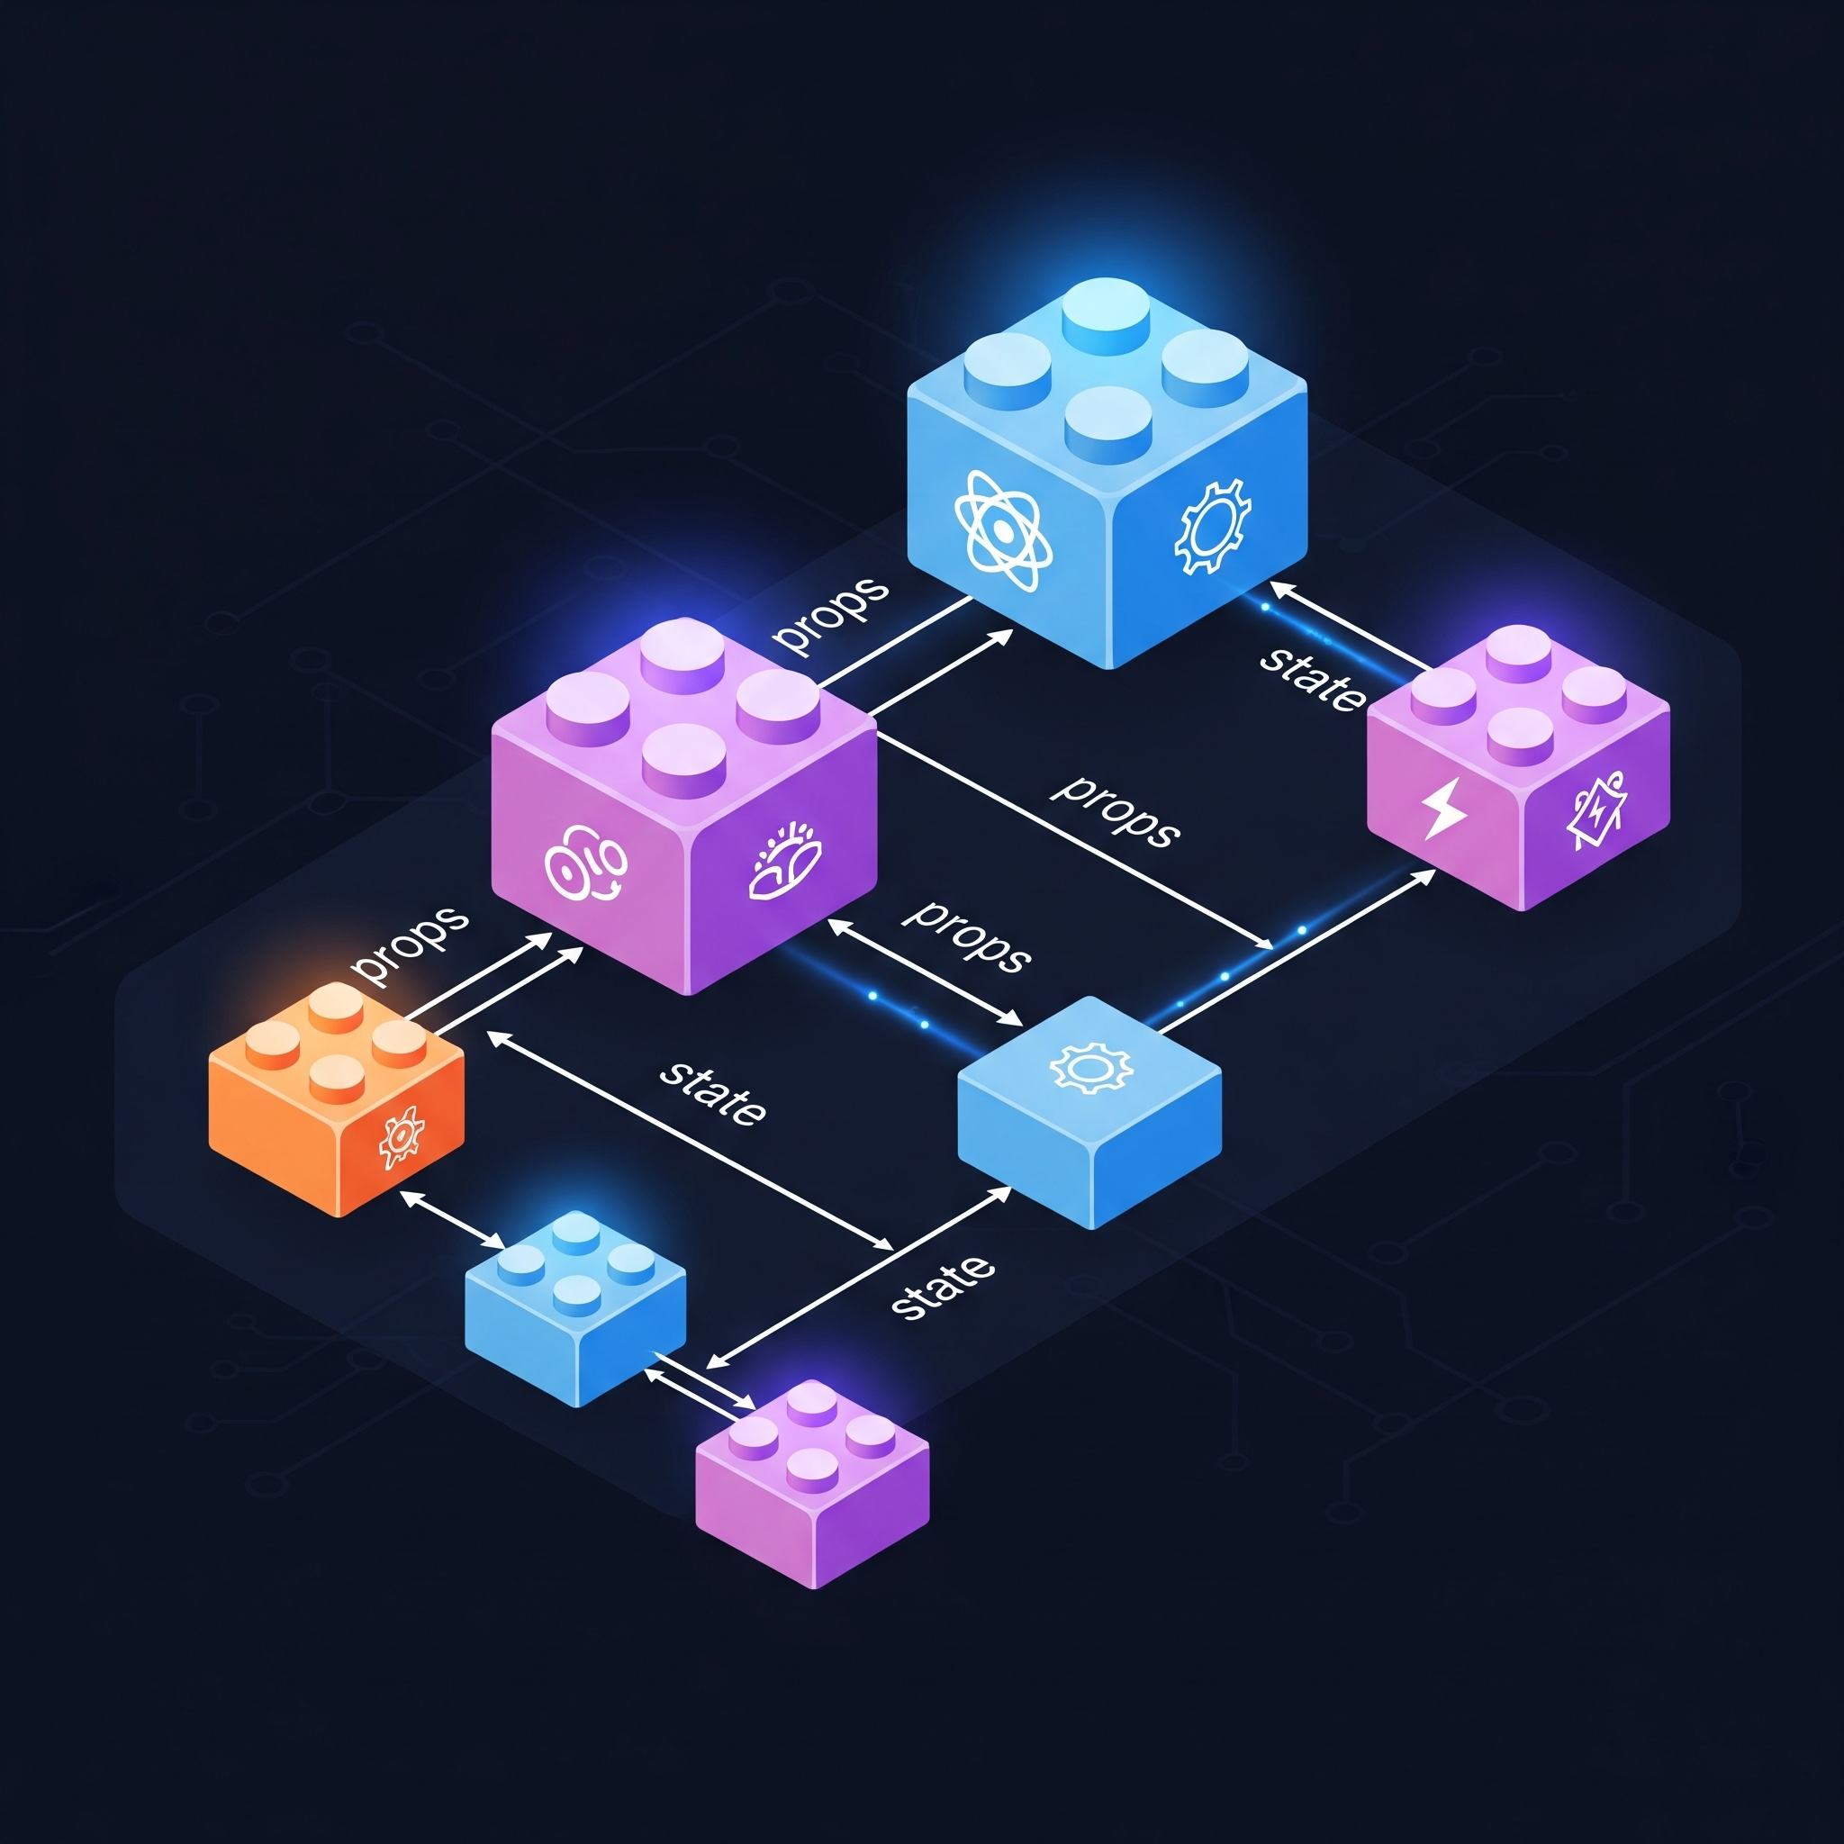
React Core Concepts
React is a JavaScript library for building user interfaces
Component-Based: components that manage their own state, composed together to make complex UIs
Virtual DOM: DOM stored in memory, making updates incredibly fast by only changing what's necessary
State describes what your UI should look like while props tell React with what content

Slide 3
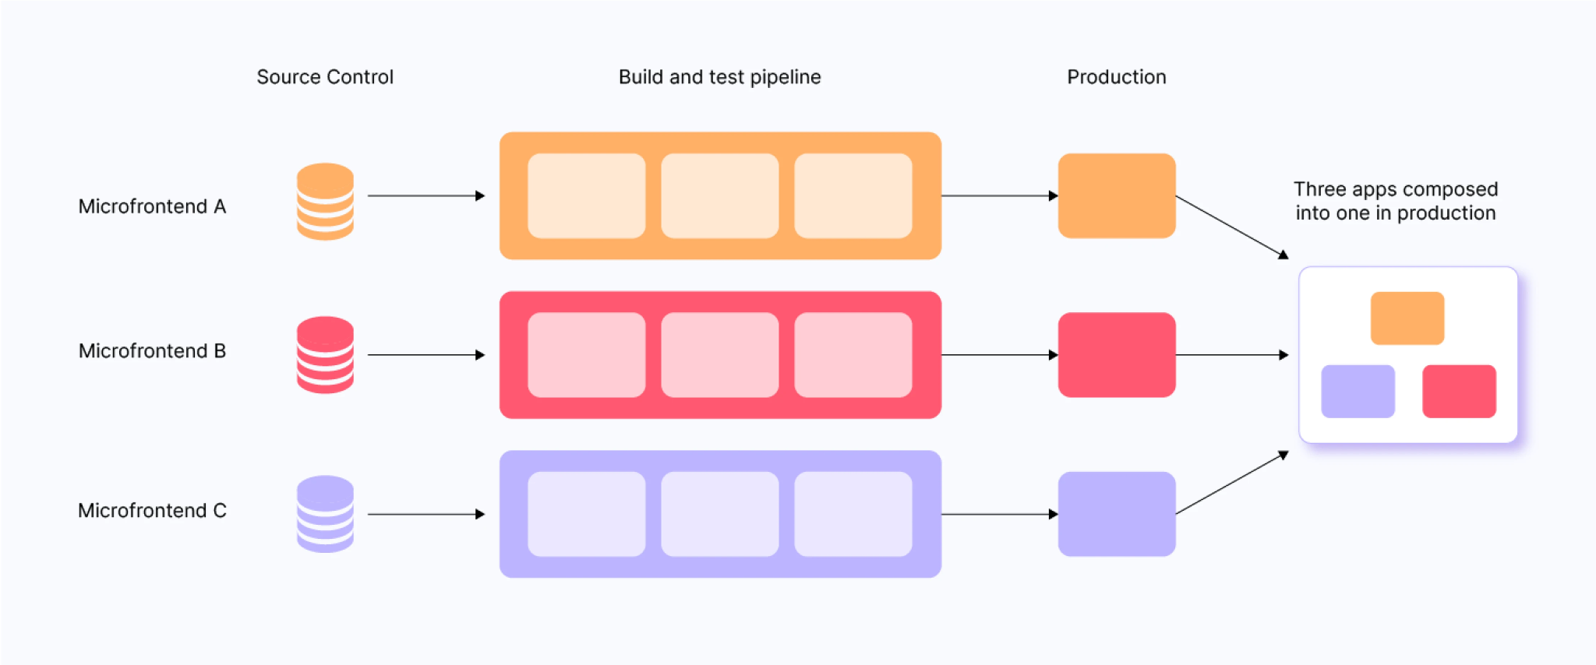
Shell Containers & Micro Frontends
The baseline for modular React Projects
Shell Containers store and manage smaller micro frontends (handle page specific routing and delivery)
Micro frontends are smaller independently deployable React projects
Modular Deployments are made easy by separable components

Slide 4
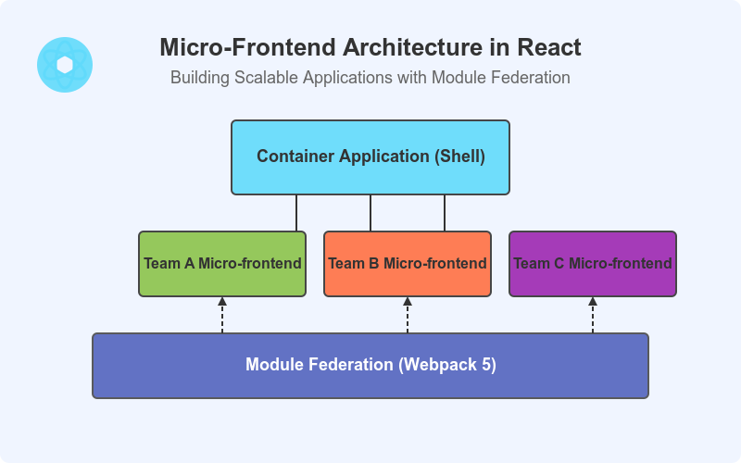
Module Federation
Interactive frontend packages
Module Federation allows micro frontends to share code and components at runtime
Configured via build tool

Slide 5
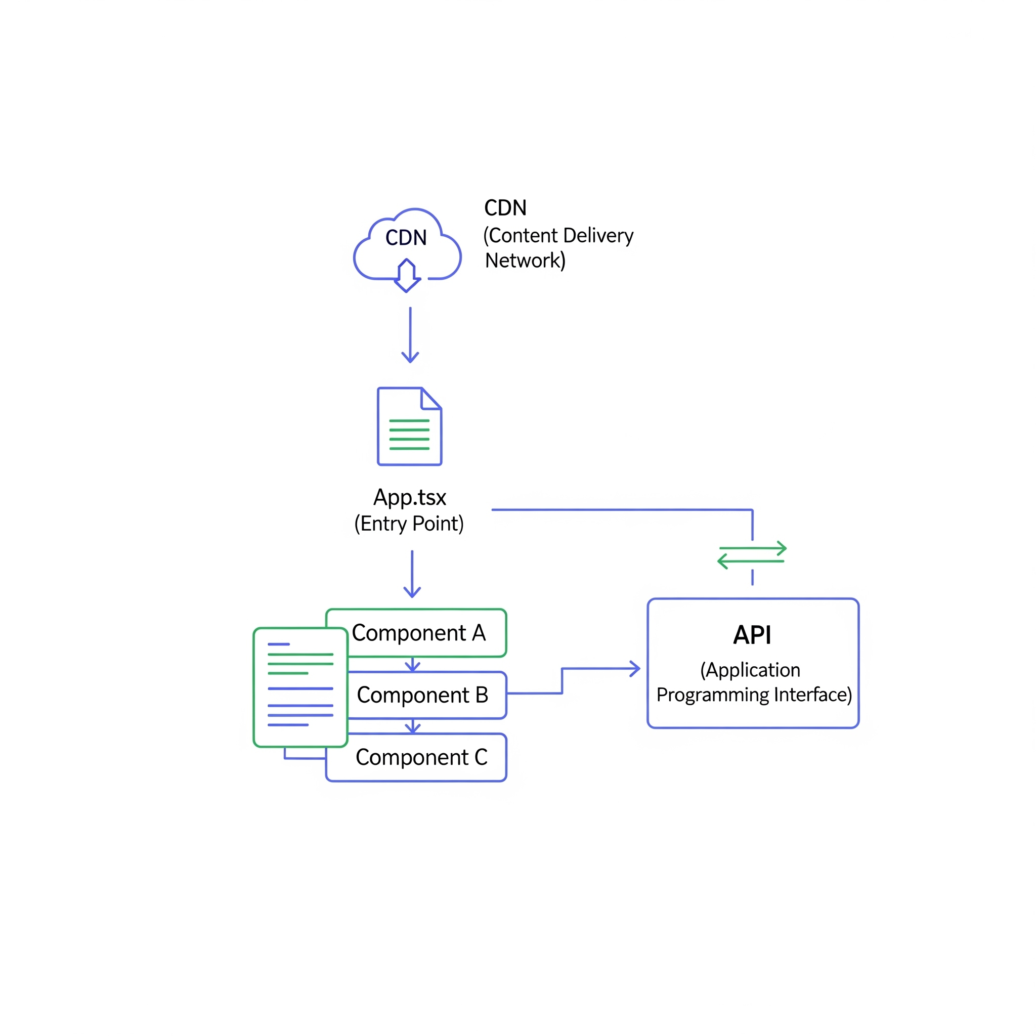
React Architecture
Built for CSR with static serving of SPA
Individual Components support dynamic UI within browser
Blazing Fast Delivery: Using a CDN, static files in a storage bucket are delivered to users (no web server needed)
API Communication: React communicates directly to API using client architecture
App.tsx is the entry point and routing hub

Slide 6
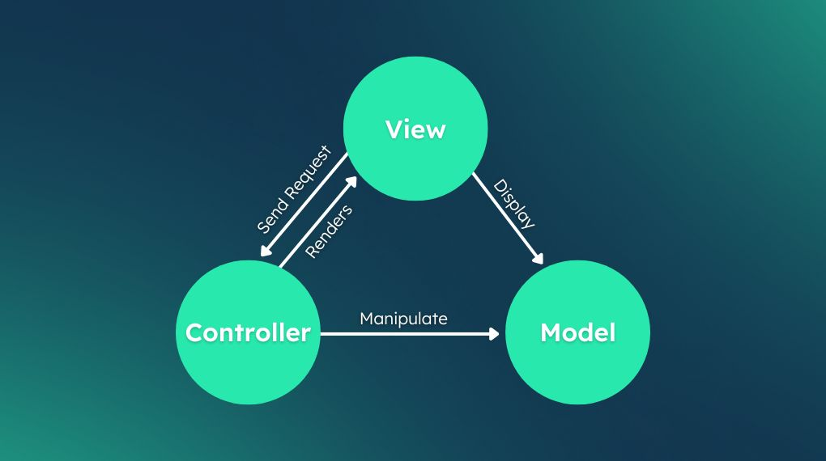
Separating Concerns - Dummy UI Framework
React separation from API & Services
Components enable simple plugin of data without concern of dependencies
API responds with data directly inserted into components after validation
This makes components easy to test and highly reusable

Slide 7

Integrated Components - Zustand
React supports a vast library of pre-made open source components
import { create } from 'zustand';
// Define the store
const useCounterStore = create((set) => ({
count: 0, // Initial state
// Actions to modify the state
increment: () => set((state) => ({ count: state.count + 1 })),
decrement: () => set((state) => ({ count: state.count - 1 })),
reset: () => set({ count: 0 }),
}));
export default useCounterStore;
As your app grows, managing shared state gets complicated. Passing props down multiple levels ("prop drilling") is messy.
Zustand is a small, fast, and scalable state-management solution
Use hooks to access and modify states
Performance: components only re-render when specific state changes

Slide 8

Integrated Components - Zod
Typescript validation with static type inference
import { z } from 'zod';
const UserSchema = z.object({
id: z.string().uuid(),
name: z.string().min(3, "Name must be at least 3 characters long"),
email: z.string().email("Invalid email address"),
age: z.number().int().positive("Age must be a positive integer").optional(),
});
// Infer the TypeScript type from the schema
type User = z.infer<typeof UserSchema>;
Zod is used to validate API response types using a Typescript Client
Where should API calls happen in React? - In stores of course!
API (defined in client) -> called in store -> validated in Typescript Client -> used in components

Slide 9


Integrated Components - UI
Pre-made UI components for UX
Utilize premade components in a UI material guide
These components have already been optimized, and pre-built perfect for React plug and use experience
For more customization pair these components with SCSS (Sassy CSS)
Allows for variables and partials

